Slide 1
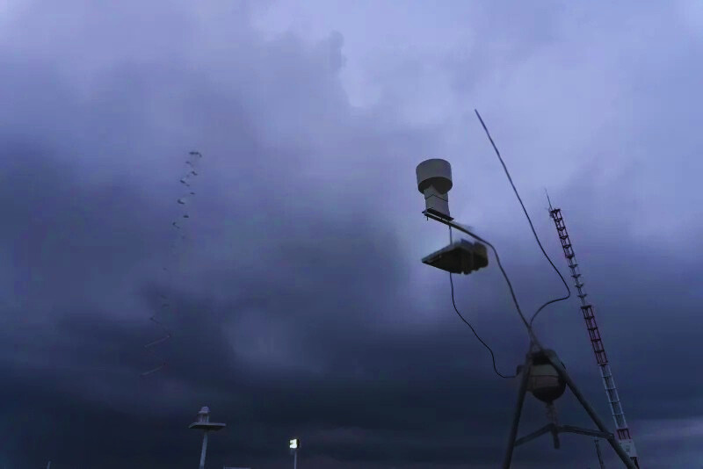
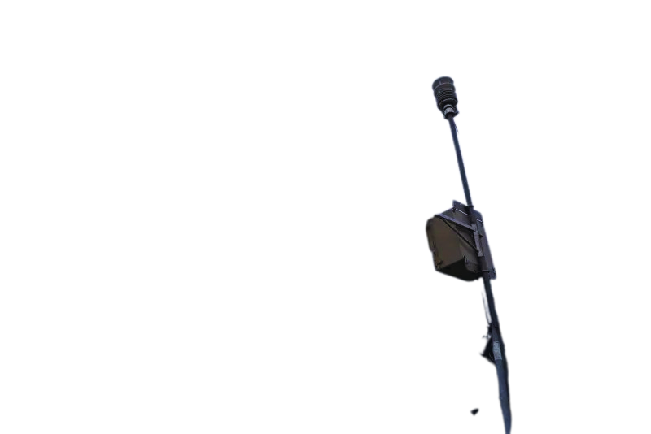

Slide 01
WeatherWise
HYPERLOCAL WEATHER FORECASTING SYSTEM
Team name: Idiosyncratic Amalgamation
Team members:
Anand S. Bhasme
Aditya R. Bharti
Asmit Kumar Roy
Abhishek Mali
1

Slide 2

PROBLEM STATEMENT
Slide 02
1.
Drastic weather changes
2.
Lack of localised weather info
3.
Unpredictability
Blogging is a great way to make money, and it doesn't have to be difficult. You can make money from your blog by
More traffic means more leads and sales for your business. If people don't know about you, they can't buy from you!
Your blog could become a book someday, or even a TV show or movie! That will bring in a ton of new customers who didn't know about you before they saw what you'd created.
Lack of Accuracy
Farmers can’t align planting and harvesting with optimal conditions
4.
5.
A lot of people think blogging is all about making money, but it's also about building relationships with people who will become lifelong customers and even friends!
Creating content for your blog is the most important part of blogging, because without content there's nothing for people to read!
2

Slide 3




Slide 03
PROPOSAL SOLUTION
Weather station on cellular tower.
Open data access to enthusiasts for Machine Learning & future AI prediction.
Community Involvement.
Personalized prediction to specialized personal ( farmers, residential solar users, etc. ).
3

Slide 4

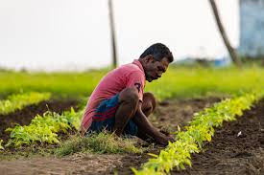


Slide 04
TARGET AUDIENCE
Farmers & agricultural workers
AI Enthusiasts
Energy Sector
Tourism
Disaster management industries
Researchers and Environmentalists
4

Slide 5







Slide 05
Technical approach
STAGE
Edge Layer / Data Collection
Weather stations on cellular towers use ESP8266/Arduino to collect and transmit local sensor data.
01
STAGE
Backend & Data Processing
02
Python backend receives, cleans, and processes incoming data in real-time.
STAGE
Database Architecture
Data is stored in a time-stamped, location-indexed format for fast retrieval and analysis.
03
STAGE
A web app shows live weather data and maps from nearby towers with intuitive charts.
04
Frontend
STAGE
Open Data & ML Integration
Open-source access allows ML enthusiasts to use the data for model training and insights.
05
5

Slide 6





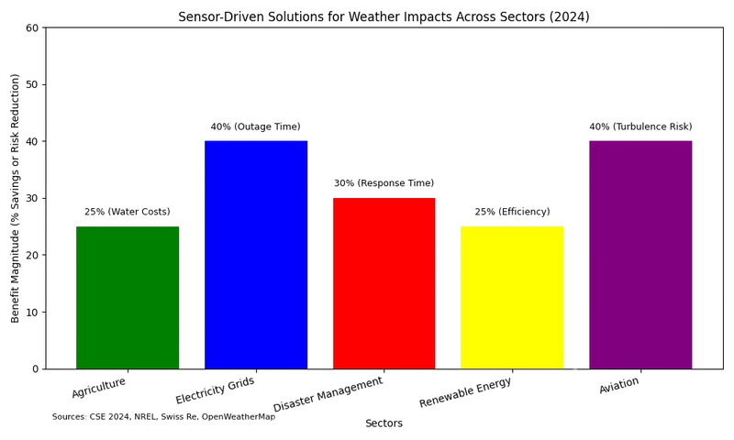
Statistics AND ANALYSIS
Agriculture
Sensors monitor temperature (25°C avg) and rainfall (50 mm/30 days), optimizing irrigation and saving 20-30% water costs.
Electricity Grids
Smart sensors detect faults (e.g., wind >60 km/h), reducing outage times by 30-50% and saving $12M/storm.
Disaster Management
Rainfall sensors (>50 mm/hr) trigger flood alerts, enhancing response and saving lives/property.
Renewable Energy
Solar radiation sensors (5 kWh/m²/day) predict output, boosting efficiency by 20-30%.
Aviation:
Wind and temperature sensors ensure safe flight planning, reducing turbulence risks by 40%.
6

Slide 7







Slide 07
impact & benefits
1. Enhanced Precision & Preparedness
People can better prepare for rain, storms, or temperature swings, improving daily life convenience and safety.
2. Disaster Risk Reduction
Helps governments and agencies mobilize resources and issue targeted alerts, reducing damage and response time.
3. Agricultural Advantages
Farmers can:
Optimize irrigation based on upcoming rain.
Choose planting/harvesting times more effectively.
Prevent crop loss due to unanticipated frost, storms, or pests (which are weather-related).
4. Smart Grid Management
Helps balance electricity supply and demand in real time by predicting peak usage periods
Enables demand-side management—utilities can prompt customers to reduce usage when needed.
5. Better Travel Planning
Tourists can choose the best times to visit destinations based on accurate local weather.
Helps avoid cancellations and discomfort due to rain, storms, or extreme heat.
7

Slide 8







5
s
B’ implementation plan
Slide 08
Blueprinting
We developed a working prototype using ESP8266/Arduino, DHT11, and essential sensors to validate hardware functionality and data flow.
Broadcasting
Deployed functional weather stations on selected sites to begin real-time data transmission and end-to-end system testing.
Bonding
Initiated partnerships with cellular tower operators and local hosts to scale deployment and expand network coverage.
Base
Built a community base of developers, students, and contributors to support open-source development and maintenance.
Briefing
We plan to share insights and data access with research institutions, companies, and policy-makers to enable practical use cases and innovations.
8

Slide 9


Slide 09
Freemium Learning Platform
Open-source access with paid premium features like advanced ML challenges, certifications, and workshops.
01
Prediction-as-a-Service (PaaS)
Top community-built ML models licensed to industries like agriculture, tourism, and energy for data-driven decision making.
02
White-Label Dashboards & Kits
Custom dashboards and deployable weather station kits sold to institutions, local bodies, and smart city programs.
03
REVENUE MODEL
API Access & Data Services
Subscription-based API access for real-time and historical weather data tailored to B2B clients.
04
Grants, Sponsorships & CSR Collaborations
Funding through educational partnerships, climate research grants, and corporate social responsibility programs.ps.
05
9

Slide 10


Conclusion and call to action
Slide 10
Our Vision
We aim to democratize hyperlocal weather forecasting by combining open hardware, community-driven machine learning, and accessible insights for all.
Call to Action
Support our deployment through partnerships with telecom or local hosts
Contribute to our open-source ecosystem—hardware, code, or models
Collaborate with us to apply localized predictions in your sector
Join our ML playground to learn, compete, and innovate
WeatherWise
Real-World Impact
From empowering farmers and tourists to assisting industries and researchers, our solution bridges the gap between raw data and actionable decisions.
10

